Slide 1
S5BD Modification for
IOPS Density
2015.3 Pan Liu

Slide 2
Content
What & Why
S5BD Architecture Flow
User Defined IOPS
Hit/Miss
Pending IO requests

Slide 3
What & Why
Using user defined IOPS density of each image, to predict the hit ratio.
We should also tune this density, according to the real IO situations.

Slide 4
S5BD Architecture Flow
aio/io R/W Interface
Control Panel
Keep Record
decompose
Task Queue
Line-up Machine
Running Task Queue
Ready Task Queue
Remove user task
Remove running task
Send task
Data Callback
Thread Pool
trigger
Send msg
Session
Receive msg
Send msg
Network

Slide 5
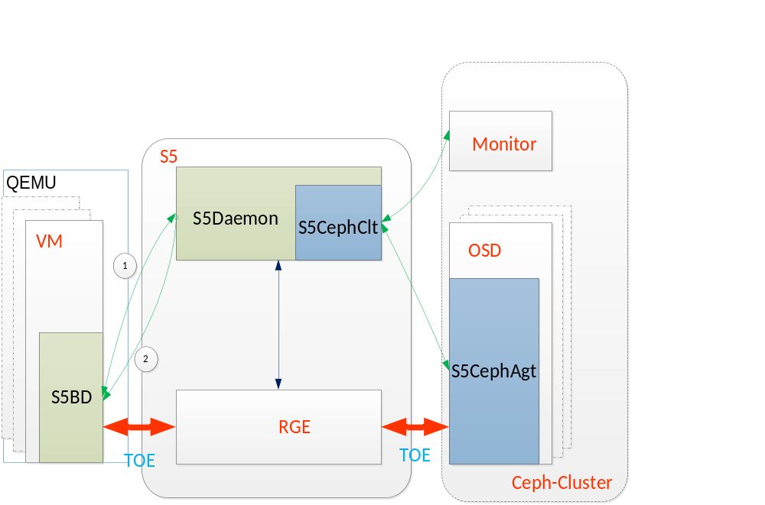
User Defined IOPS
The higher user bought IOPS density is, the higher priority his IO requests
should have.
Use (1) to get image IOPS density(user defined) from S5Daemon,
when image_open.
When the image IOPS density is changed by user, S5Daemon will send this
change to S5BD automatically, by (2).

Slide 6
Hit / Miss
Because the resource of RGE is rush, we should priority
handle the hit requests.
Miss requests could wait a short moment in S5BD.
In the same 4M, if the previous requests is under retry,
current request should be blocked in S5BD.

Slide 7
Pending IO Requests
Running Queue
Ready Queue
4M block node
Running unit node
Ready unit node
Num of Running + 0.5 * Num of Ready

Slide 8
Conclusion
Block the missed requests until loading finish.
Propose a cost function:
  a*(user defined IOPS density) + b * (pending IO requests)
  a + b = 1
Priority:
  User defined IOPS density > pending IO requests

Slide 9
Future
Consider IOPS completeness.
Consider frequency in Cache Replacement algorithm.

